Slide 1
PHY 211: Elementary modern Physics (2 Units)
Special theory of relativity (week 1)
DR OKAFOR P.N.
DEPARTMENT OF PHYSICS
COLLEGE OF SCIENCE AND TECHNOLOGY
CONVENANT UNIVERSITY
2025/2026

Slide 2
OBJECTIVES
At the end of the lecture, the students are able to
Explain special theory of relativity
Explain “inertial frame of reference”
Explain the Galilean transformation
Explain the Lorentz transformation

Slide 3
Special theory of relativity
One of the great theories of physics appeared in the 20th century when Albert Einstein presented his special theory of relativity in 1905.
We learned in introductory physics that Newton’s laws of motion must be measured relative to some reference frame. A reference frame is called an inertial reference frame, if Newton’s laws are valid in that frame.
If a body is subjected to no external force, and moves in a straight line
with constant velocity, then the coordinate system attached to that body defines an inertial reference frame.

Slide 4
Special theory of relativity
If Newton’s laws are valid in one reference frame, then they are also valid in another reference frame moving with a uniform velocity relative to the first system. This is known as the Newtonian principle of relativity, or Galilean invariance.
Newton showed that it was not possible to determine absolute motion
in space by any experiment, so he decided to use relative motion.
In addition, the Newtonian concept of time and space are completely
separable.

Slide 5
Special theory of relativity
Consider two inertial reference frames K and K’ moving along their x and x’ axes. respectively, with uniform velocity v as shown in fig 1
We note system K’ is moving to the right with velocity v with respect to system K which is moving or stationary somewhere.
One result of the relativity theory is that there are no fixed absolute frames of reference.

Slide 6
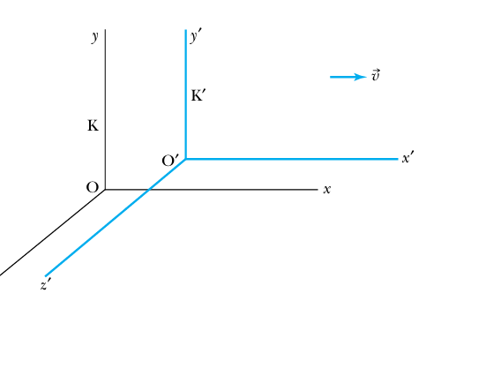
Special theory of relativity

Slide 7
Special theory of relativity
We use the term fixed to refer to a system that is fixed to a particular object, such as a planet, or spaceship, that is moving in space. The transformation of the coordinates of a point in one system to the other system is given by
x’ = x –vt
y’ = y
z’ = z (1)

Slide 8
Special theory of relativity
Similarly, the inverse transformation is given as
x = x’ + vt
y = y’
z = z’ (2)
where we have set t =t’, because newton considered time to be absolute.

Slide 9
Special theory of relativity
Equations 1 and 2 are known as the Galilean transformation. Newton’s laws are invariant under a Galilean transformation, that is they have the same form in both systems K and K’.
In the late nineteenth century, Albert Einstein was concerned that although Newton’s laws of motion had the same form under a Galilean transformation. Maxwell’s equation did not.

Slide 10
Special theory of relativity
Einstein in 1905 proposed that space and time are not separable and that Newton’s laws are only an approximation. This concept is called the special theory of relativity.
Question Explain the special theory of relativity
Answer. The special theory of relativity postulates the following
1 The laws of physics are the same in all inertial systems. There is no way to detect absolute motion and no preferred inertial system exists
2 Observers in all inertial systems measure the same value for the speed of light in a vacuum.

Slide 11
Special theory of relativity
Space and time are not separable
The first postulate indicates that the laws of physics are the same in all
coordinate systems moving with uniform relative motion to each other.
Although, Newton’s principle referred only to the laws of mechanics, Einstein expanded it to include all laws of physics including those of electromagnetism

Slide 12
Special theory of relativity
Question: What is an inertial frame of reference?
Answer: An inertial frame of reference is that frame of reference in which all laws of physics are valid.

Slide 13
Special theory of relativity.
Due to the special theory of relativity, there is transformation of momentum, force and energy.
Maxwell’s equations in electromagnetism, don’t require change, because electric and magnetic effects are relative depending on the observer.

Slide 14
Simultaneity
The figure below explains simultaneity. There are two reference frames K and K’. We assume t = t’. Each system has it’s observer with it’s own clock and meter stick. An event in a given system must be specified by stating both it’s space and time co ordinates.
Consider the flashing of two bulbs fixed in system K as shown below.
Mary is in system K’ (the moving system). She is beside Frank who is in system K (the fixed system) and the light bulbs are flashed.

Slide 15
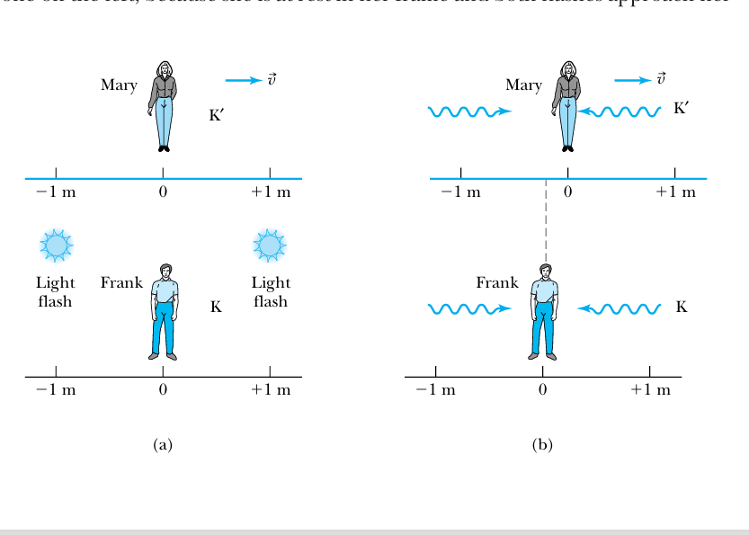
Simultaneity

Slide 16
Simultaneity
As seen in (b), the light pulses travel the same distance in system K and arrive at Frank simultaneously. Frank sees the two bulbs at the same time. However the two light pulses do not reach Mary simultaneously
because system K’ is moving to the right and she has moved closer to the bulb on the right by the time the flash reaches her. The light flash
coming from the left will reach her at some later time.
Mary thus determines that the light on the right flashes before the one on the left, because she is at rest in her frame, and both flashes approach her at speed c.

Slide 17
Simultaneity
We conclude that two events that are simultaneous in one reference frame (K) are not necessarily simultaneous in another reference frame K’ moving with respect to the first frame.
Question: Explain the problem of simultaneity
Answer Two events that are simultaneous in one reference frame (K) are not necessarily simultaneous in another reference frame (K’) moving with respect to the first frame.

Slide 18
Galilean transformation
Question: What is the Galilean transformation?
Answer: The Galilean transformation states that Newton’s laws of motion are invariant in inertial frame of reference. This means newton’s laws of motion have the same form in an inertial frame K
and in another frame K’ moving with uniform velocity v with respect to the first.

Slide 19
The Lorentz transformation
The Lorentz transformation states that the laws of physics are invariant between inertial frames of reference. Looking at fig 2
t = t’ = 0 since the origin of the two co ordinate systems coincide with one another, and system K’ is travelling along the x and x’ axis. Then the Lorentz transformation equations are

Slide 20
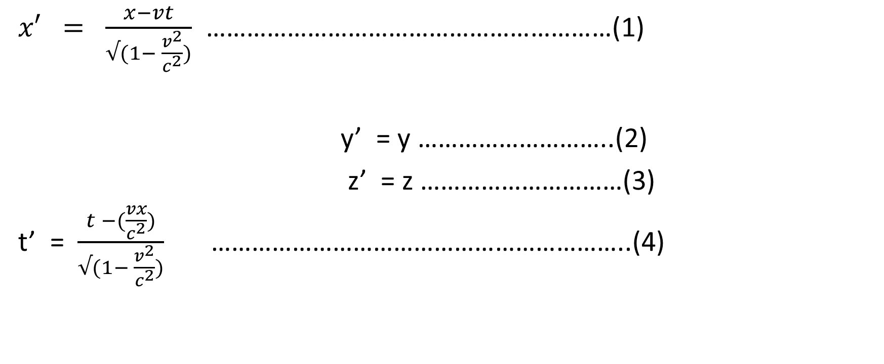
Lorentz transformation
$x′ = \frac{x−vt}{√(1− \frac{v^{2}}{c^{2}})}$ ……………………………………………………(1)
y’ = y ………………………..(2)
z’ = z …………………………(3)
t’ = $\frac{t −(\frac{vx}{c^{2}})}{√(1− \frac{v^{2}}{c^{2}})}$ ……………………………………………………..(4)

Slide 21
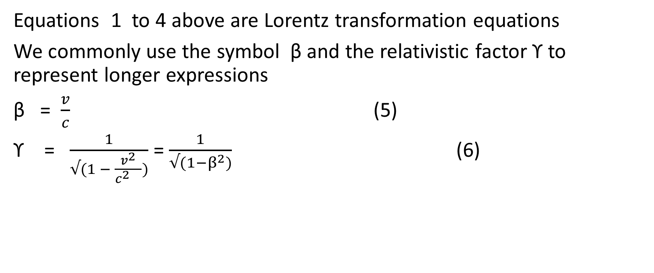
Special theory of relativity
Equations 1 to 4 above are Lorentz transformation equations
We commonly use the symbol β and the relativistic factor ϒ to represent longer expressions
β = $\frac{v}{c}$ (5)
ϒ = $\frac{1}{√(1 − \frac{v^{2}}{c^{2} })}$ = $\frac{1}{√(1−β^{2})}$ (6)

Slide 22
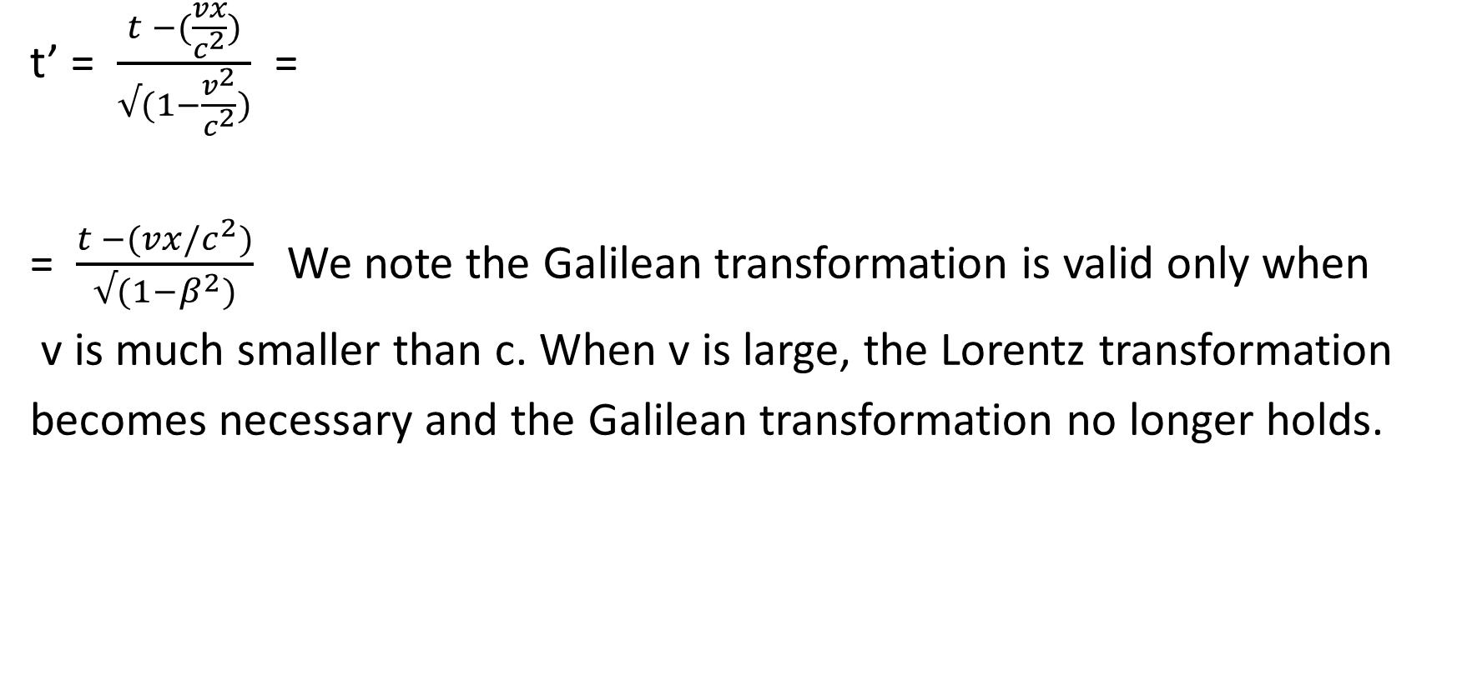
Special theory of relativity
t’ = $\frac{t −(\frac{vx}{c^{2}})}{√(1−\frac{v^{2}}{c^{2}})}$ =
= $\frac{t −(vx/c^{2})}{√(1−β^{2})}$We note the Galilean transformation is valid only when
v is much smaller than c. When v is large, the Lorentz transformation
becomes necessary and the Galilean transformation no longer holds.

Slide 23
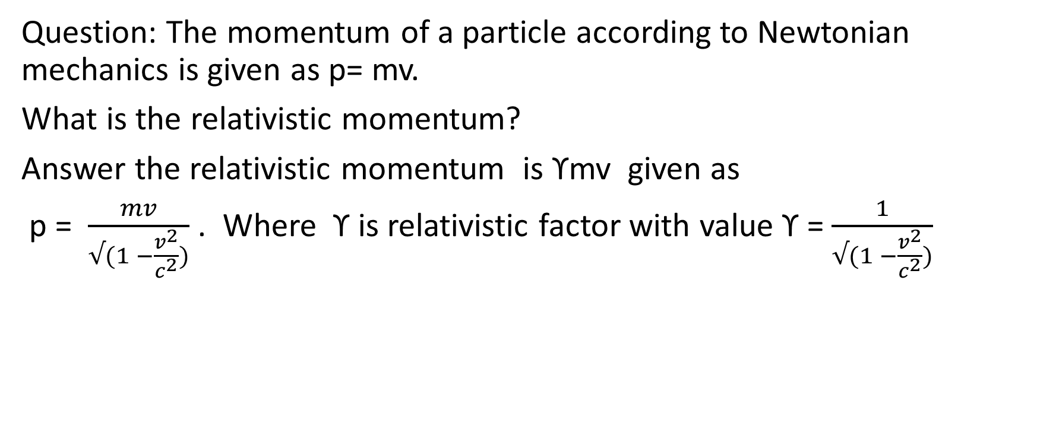
Example
Question: The momentum of a particle according to Newtonian mechanics is given as p= mv.
What is the relativistic momentum?
Answer the relativistic momentum is ϒmv given as
p = $\frac{mv}{√(1 −\frac{v^{2}}{c^{2}})}$ . Where ϒ is relativistic factor with value ϒ = $\frac{1}{√(1 −\frac{v^{2}}{c^{2}})}$

Slide 24

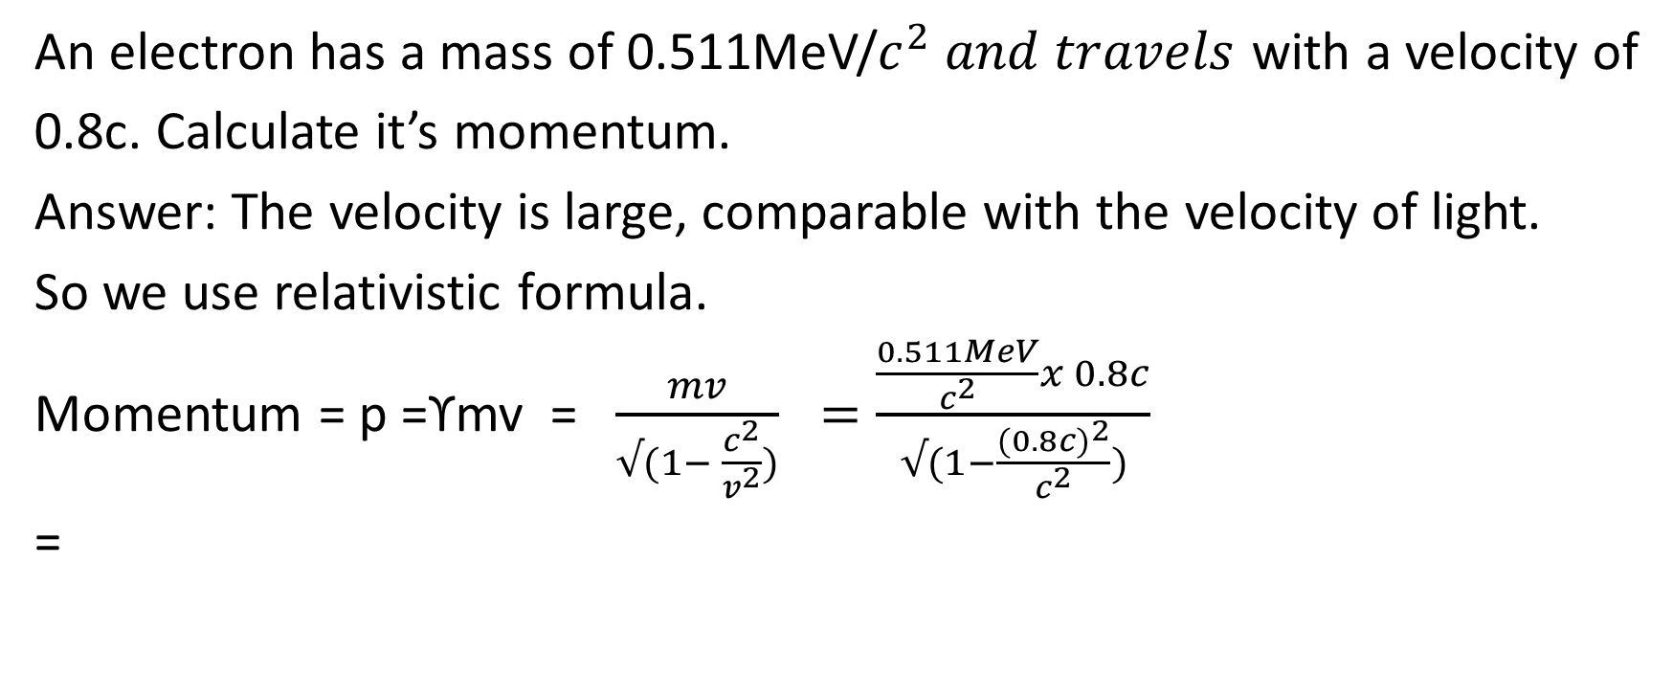
Example 2
An electron has a mass of 0.511MeV/$c^{2} and travels$ with a velocity of
0.8c. Calculate it’s momentum.
Answer: The velocity is large, comparable with the velocity of light.
So we use relativistic formula.
Momentum = p =ϒmv = $\frac{mv}{√(1− \frac{c^{2}}{v^{2}})} =\frac{\frac{0.511MeV}{c^{2}}x 0.8c}{√(1−\frac{{(0.8c)}^{2}}{c^{2}})}$
=

Slide 25
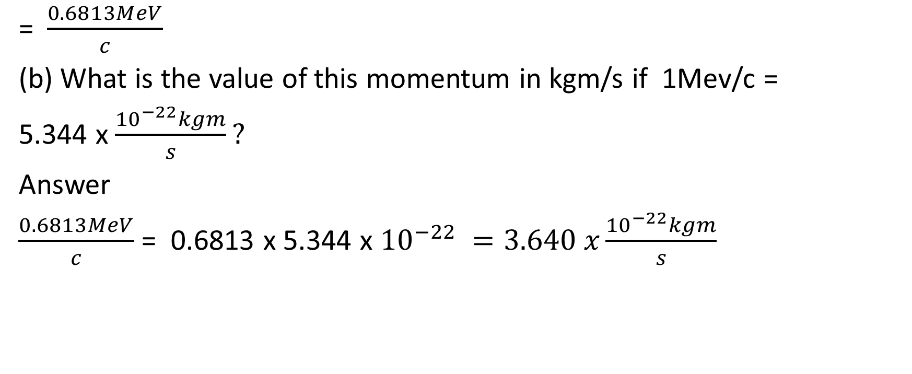
Solution to example 2
=$\frac{0.6813MeV}{c}$
(b) What is the value of this momentum in kgm/s if 1Mev/c =
5.344 x $\frac{{10}^{−22}kgm}{s}?$
Answer
$\frac{0.6813MeV}{c}$ = 0.6813 x 5.344 x ${10}^{−22} =3.640 x\frac{{10}^{−22}kgm}{s}$

Slide 26
Review Questions
By means of equations, write down the Galilean transformation
In 3 sentences, explain the special theory of relativity.
What is an inertial frame of reference?
Using two reference frames K and K’, explain simultaneity
What is Galilean transformation?
Explain Lorentz transformation
Write down 4 equations showing Lorentz transformation

Slide 27
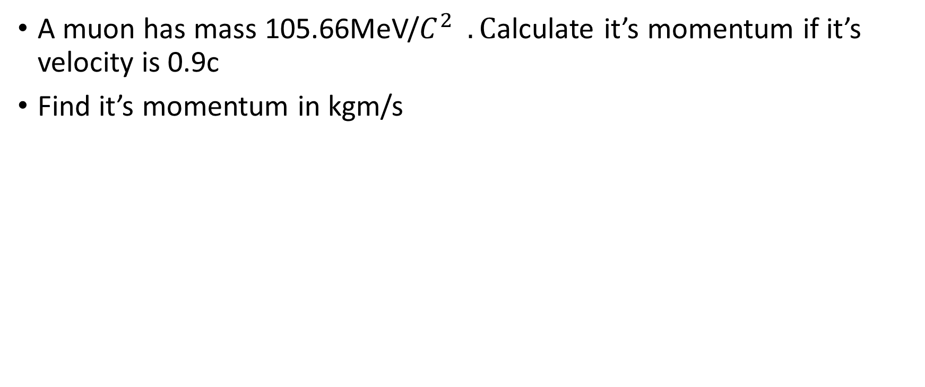
Review Questions contd
A muon has mass 105.66MeV/$C^{2} .C$alculate it’s momentum if it’s velocity is 0.9c
Find it’s momentum in kgm/s

